Slide 1
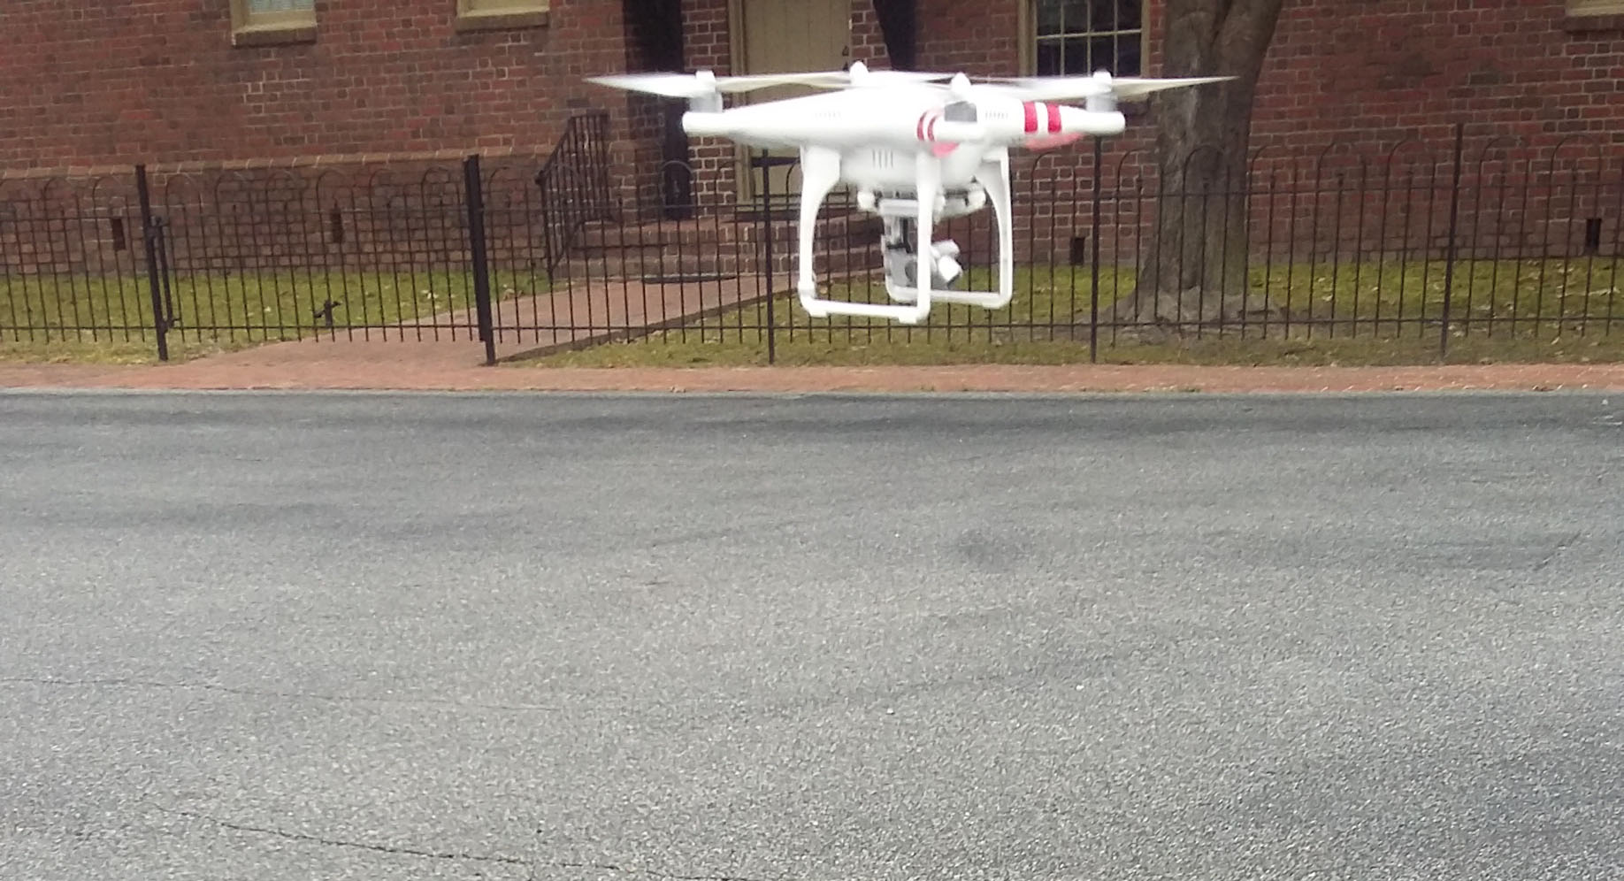
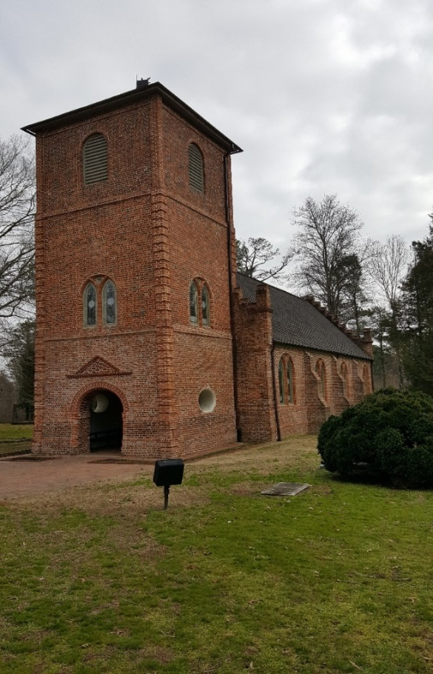
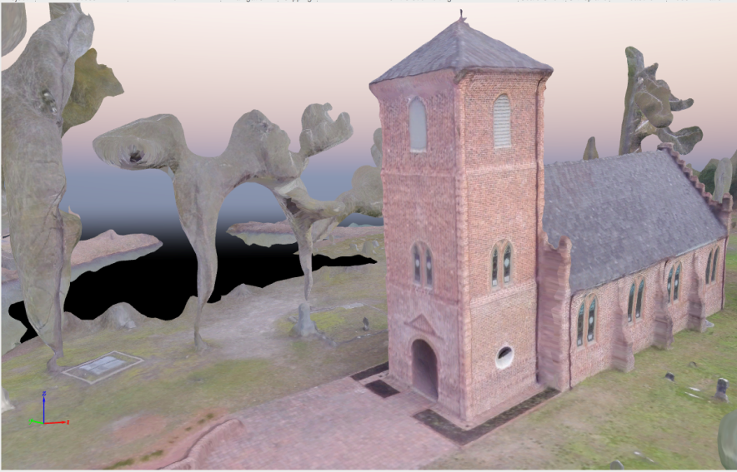
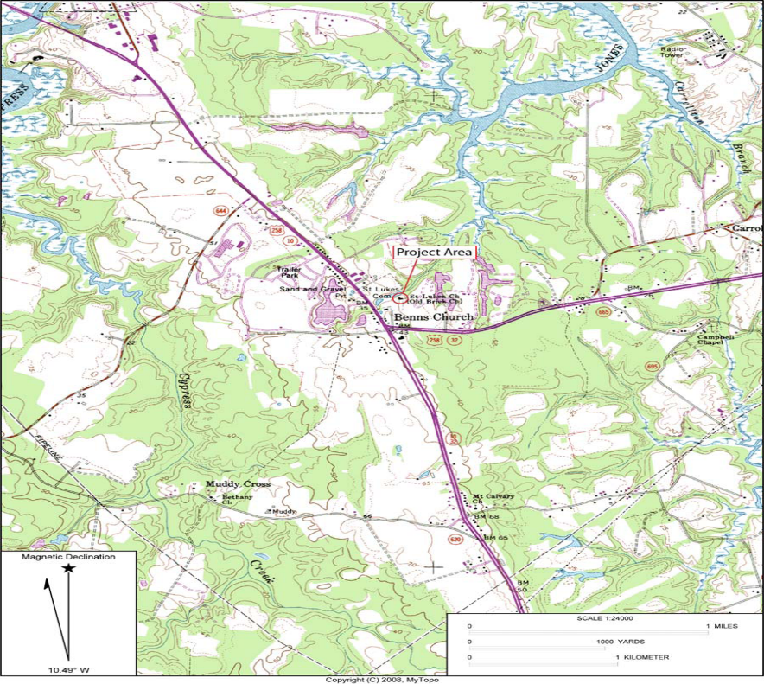
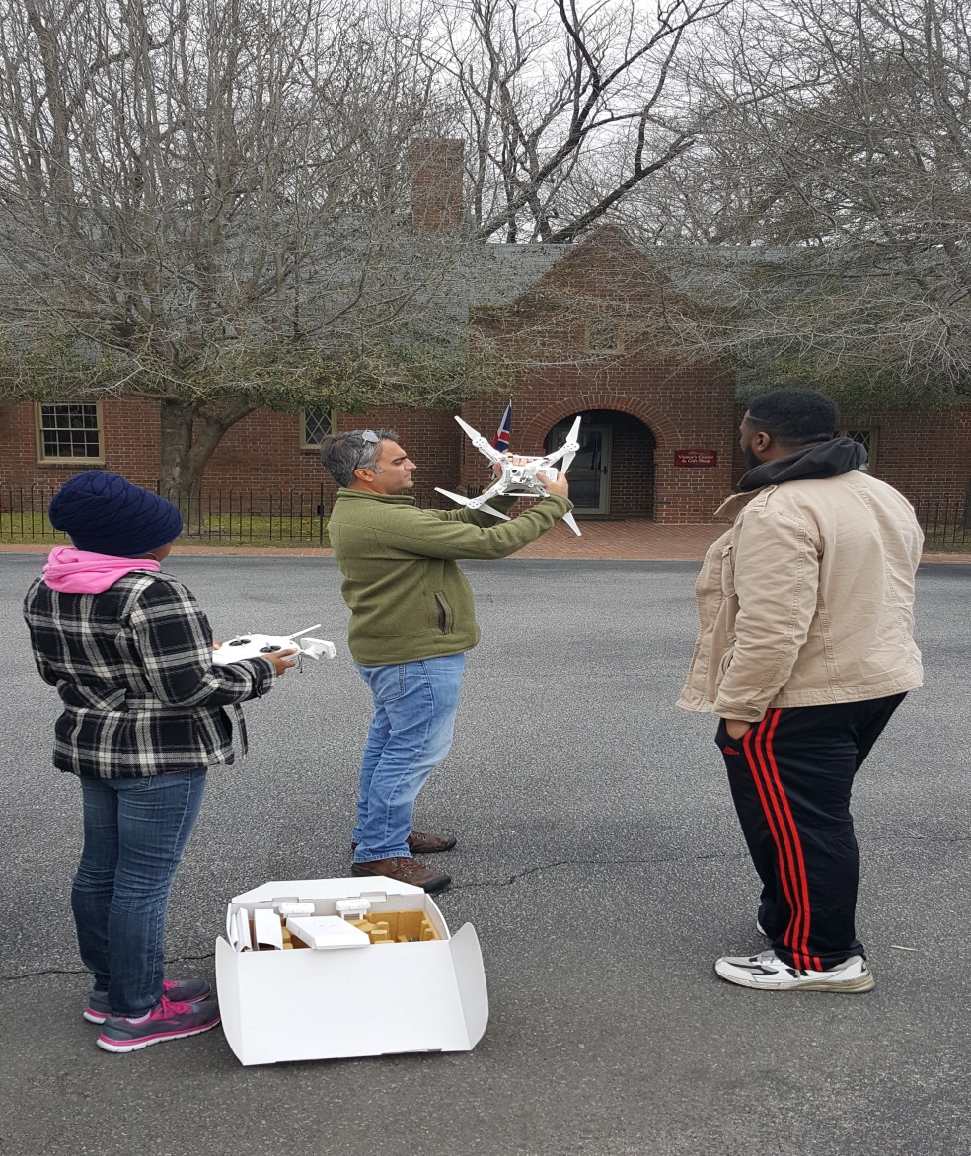
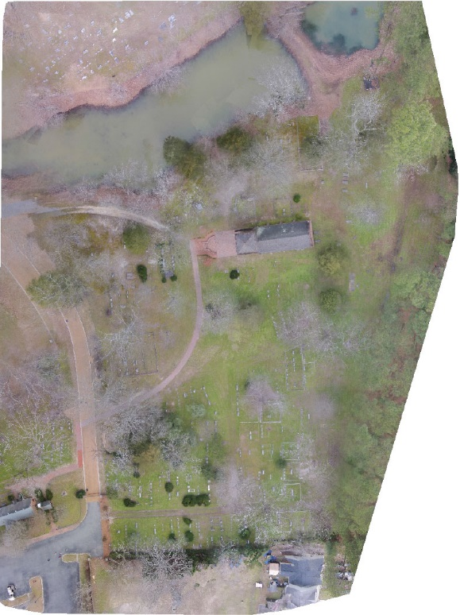
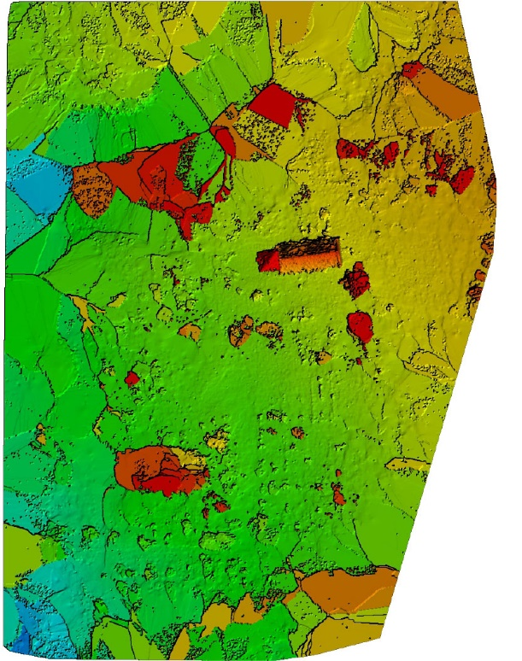
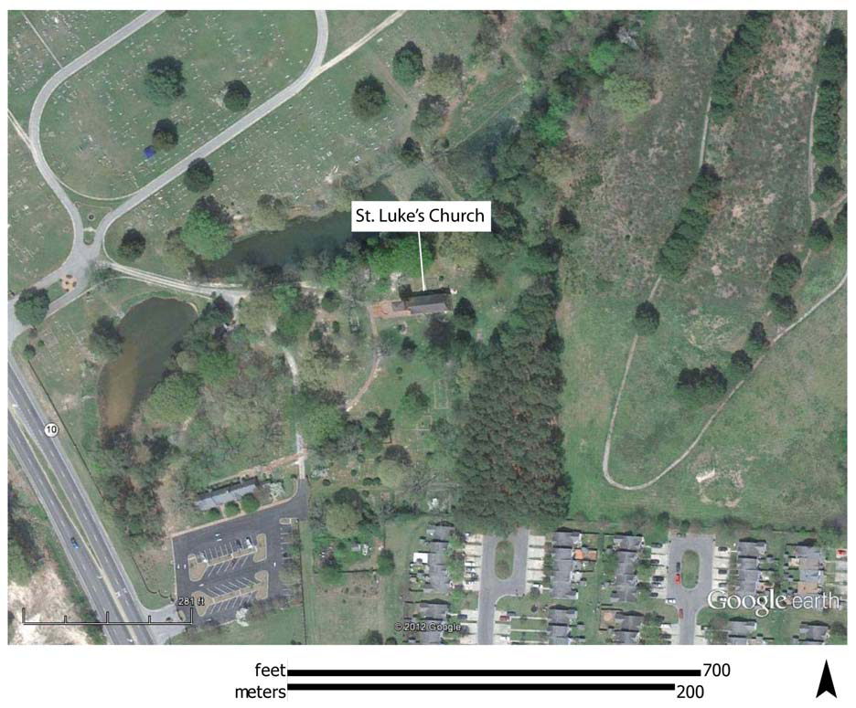
Acknowledgement
The team extends a hand of appreciation to Clay Swindell for his guidance, contributions, and help with completing this research. Also, the team acknowledges Dr. Linda Hayden for the research opportunity that was made possible through the CERSER program, Dr. Malcolm LeCompte for supplying the DJI Phantom 2 Vision+. We also would like to express our gratitude to St. Luke’s Church for providing access to the property.
Producing 3D point cloud and digital elevation models through the use of Unmanned Aerial Vehicles, Historic St. Luke’s Church case study
Team Members: Tangee Beverly, Cornelius Holness, Nigel Pugh, Tori Wilbon Mentor: E. Clay Swindell Elizabeth City State University
Abstract
Objective
Equipment
The primary piece of equipment used to conduct this research was the DJI Phantom 2 Vision+ U.A.V. with a built-in Naza­M V2 Flight Control System and integrated gimbal and camera (Fig. 5) [1]. The Phantom 2 Vision+ is a two pound remote-controlled quadcopter that contains four rotating wings capable of stable flight and taking high resolution pictures and video.
The video is captured at 1080 pixels/30 frames per second and 720 pixels/60 frames per second, and contains the option for the user to shoot slow motion video [1]. The JPEG type photos taken at 14 megapixels are captured by the camera operated on a stabilizer, which is a benefit that eliminates unsteady video and images caused by the four motors. The U.A.V. can operate autonomously or with minimal pilot training, fly at and up to 1000 ft. in calm wind and as fast as 15 meters/second with the four basic directions of flight pitch (forwards and backwards), roll (left and right), elevator (up and down) and yaw (turn left or right) [1]. The DJI has a built-in inertial sensor and a barometric altimeter that measures both attitude and altitude. Also, the quadcopter operates on a flight time of approximately 25 minutes [1]. In retrospect, the DJI Phantom 2 Vision+ U.A.V. turned out to be very cost effective and versatile regarding its numerous functions and uses.
In retrospect, the DJI Phantom 2 Vision+ U.A.V. turned out to be very cost effective and versatile regarding its numerous functions and uses.
Image/Image Processing
In order to process the images captured by the DJI Phantom’s visible light camera, the team generated a photo mosaic as an effective way of analyzing the field data collectively. The term photo mosaic refers to one complete image that is formulated by the piecing together of multiple images. The images taken during the flight along the transects were composed into a photo mosaic using the image processing software Pix4D, which converts a multitude of images into "geo-referenced 2D mosaics and 3D models", useful for mapping and modeling (Fig. 7) [5]. A 64-bit trial version of Pix4DMapper (Discovery Version) for Macintosh OS X was downloaded to a 256GB 2015 Macbook Pro Retina with 2.7GHZ processor and 8 gigabytes of RAM. The 147 images collected and stored as JPEG on SD cards provided with the DJI Phantom were transferred to a 8gb flash drive. From that point forward, the images were inserted into the Pix4D Mapper application project folder. Then the software took the individual images taken along the transects, determined the overlap between each image by searching for commonalities, and then composed the images collectively into a 3D photo mosaic model of St. Luke’s church and its parameters. Nineteen hours were taken to fully process the 147 images from the three trips to create the photo mosaic. In addition to creation of the the photo mosaic, the team provided St. Luke's with elevation models of the property, and multiple fly-throusghs of the property.
Selecting the Pix4d software became an excellent resource for the research team. By downloading the software, Pix4D provided an application for mobile devices that was used in the field to map transects for the automated flight. Once transects were mapped, the U.A.V. automatically flew at a constant elevation of 50 meters along the route taking aerial images at every point mapped until completion. This resulted in 147 overlapping images that would later be used to produce a larger mosaic image and 3D point cloud. The benefit of this automation was that the team did not have to manually fly the U.A.V. Manual flight of the U.A.V. could have resulted in various elevation changes throughout flight due to the strain of manually trying to make the elevation constant and the chance of over-mapping as well as under-mapping transects points, which could have produced an unreliable geo-referenced photo mosaic of the surveyed area. However, the team did manually take a flight with the U.A.V. , which aided in the 3d model and point cloud coming out so well.
Results
This research project was initiated to demonstrate the ability of Unmanned Aerial Vehicles (UAV) to gather elevation and 3D data using only a visible light camera. The chosen test case was the structure and property associated with Historic St. Luke’s Church. This historic property represents Virginia’s oldest standing church built in the late 17th century. While the property area associated with the church covers several acres, The UAV team chose to focus on the historic structure and immediate surrounding area. The intention was to fly a DJI Phantom 2 Vision+ UAV along a gridded flight plan designed to capture an array of images at defined intervals. These images were subsequently processed with the Pix4d software to produce an image mosaic of the gridded area, a 3d point cloud and digital elevation model (DEM), and finally a 3D model of the historic structure. The dataset will expand on the historical and the geographic placement of the structure and will assist Historic St. Luke's in directing future archaeological and landscape studies on the property.
Keywords—archaeology, aerial imagery, DJI Phantom 2 Vision+, drone, remote sensing, U.A.V.
The primary objective for this project was to produce aerial imagery from which structural and elevation models could be generated. A secondary objective was to make this data available to the church so that it could be used in future archaeological and landscape studies. To achieve these objectives we made use of an U.A.V. platform equipped with a visible light camera to produce a series of images the software could interpolate 3D information.
.
The goal of our research being to produce aerial imagery and elevation models that can be used for future use of research exploration on the property of St. Luke’s. Our analysis of the 3D meshes are that they are a realistic and accurate representation of the St. Luke’s Church and surrounding property.
It is to be noted, that using our manual flight around the church structures aided the other images that were collected from the computerized flight (using Pix4D mobile application) in creating such a enriched 3D mesh of St. Luke’s. The team believes the aerial imagery, elevation models, and 3D meshes were all adequate and accurate to be used for future research excavations and exploration for St. Luke’s Church
Methodology
Area of Interest (A.O.I)
St. Luke’s is a historical landmark located in Smithfield, Virginia. St. Luke's was previously known as The Newport Parish Church, also known as the “ Old Brick Church” . St Luke’s is considered to be one of the oldest surviving ecclesiastical buildings in the state of Virginia. Longstanding tradition says it was built in the early 1630’s however a more recent dendrochronology study points to the original structure being build in the early 1680’s. This church is a brick building with a unique tower with gothic styling. Reverend W.G.H Jones informally renamed the church St. Luke's in 1828.
St. Luke’s church has had previous archaeological investigations and excavations. The first excavation took place in 1894. Colonel Joseph Bridger was removed from his plantation and buried in the church’s chancel. In the 1950’s excavations were revealed three successive masonry floors. The first archaeological investigation took place in January 2007 when Archaeological & Cultural Solutions Inc. (ACS) and the Smithsonian Institution analyzed the remains of Colonel Joseph Bridger. In the same year ACS monitored the trenching for a new storm water drainage system. The excavations of the trenches measured 60 feet long, 5 feet wide, and 2 feet deep. These excavations bore ten unmarked graves.
Introduction
Throughout previous years, the use of U.A.V. technology has become more prevalent in today's society. U.A.V.s have emerged from expensive unconventional property to being used for inexpensive personal recreational use. The accessibility to U.A.V.s and its capabilities offer advantages in obtaining aerial imagery and structural elevation models that have many applications including uses in humanitarian response, environmental studies, remote sensing research, and archaeological studies.
Evaluating emerging technologies like U.A.V.s have always aided archaeology and provided archaeologists with the ability to identify and study sites without having to disturb them. Remote sensing, as it is called, affords researchers the ability to study sites and landscapes in a non-destructive manner and allows them to focus their limited resources on areas likely to yield results. While the process of remote sensing archaeological sites has been around for many decades, modern advances in U.A.V. technology make it much more accessible to smaller teams and projects.
Researchers and students at the Center of Excellence in Remote Sensing Education and Research (CERSER) program at Elizabeth City State University decided to explore the potential of U.A.V.s to aid archaeological studies in the region. The primary goal of this research was to produce aerial imagery from which structural and elevation models could be generated. The team focused on the historical landmark Historic St. Luke's Church located in Smithfield, Virginia.
Conclusion
Research was successful in that the team achieved the primary and secondary objectives which were to produce aerial imagery from the structural and elevation models and to make the data available to the church so that it could be used in future archaeological and landscape studies using the U.A.V platform. By creating 3D structural and elevation models for St. Luke's Church, 147 images were captured and stitched together to generate photo mosaics of the property using Pix4d Discovery software. Conclusively, St. Luke's Church can benefit from this research by using the methodology and products produced for future excavations and research endeavors.
References
[1] Phantom 2 Vision+ User Manual, V1.6, DJI Co., Los Angeles, CA, 2015, pp. 5-12.
[2] Digital globe, USDA Farm Service Agency Map Data (2015). Google Maps [Online]. Available: https://www.google.com/maps
[3] Pix4D Co. (2015). Pix4D: simply powerful [Online]. Available: https://pix4d.com/\
[4] Matthew R. Laird, Ph.D, and Anthony W. Smith, M.A. ARCHAEOLOGICAL TESTING ASSOCIATED WITH A DRAINAGE INSTALLATION PROJECT AT ST. LUKE’S CHURCH (046-0024/44IW0271) ISLE OF WIGHT COUNTY, VIRGINIA. Williamsburg, VA: James River Institute for Archaeology, Inc., 2012. Print.

